Slide 1
Do Compact Galaxies Have Higher Ionizing Photon Production Efficiencies?
By: River Schmidt-Eder
Mentor: Anthony Pahl
Notes:
Hi everyone my name is River Schmidt-Eder I’m studying with Anthony Pahl and for our project we are correlating the ionizing photon production efficiency of galaxies to their effective radii to better understand how the two things are related.

Slide 2
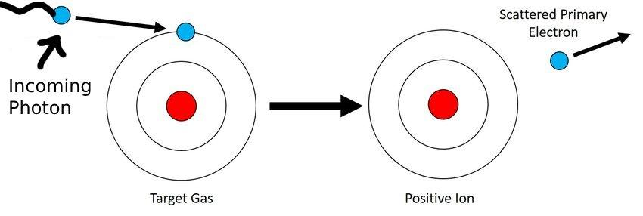
What are Ionizing Photons?:
(Adapted from Krafft 2020)
Notes:
Getting into our our first piece of context, what are ionizing photons?
If you’re watching this presentation chances are you’ve all heard of a photon,
and if you have any knowledge of chemistry you are likely also familiar with ions. Taking those two things together we essentially get a photon that’s capable of ionization.
What might be on your mind though is how that actually occurs.
Essentially what happens is that a photon or a particle of light with enough energy comes into contact with a negative electron from an atom and knocks it out of its place. In the case of hydrogen this leaves us with a singular remaining proton with a positive charge. You might be thinking though, why does this matter?

Slide 3
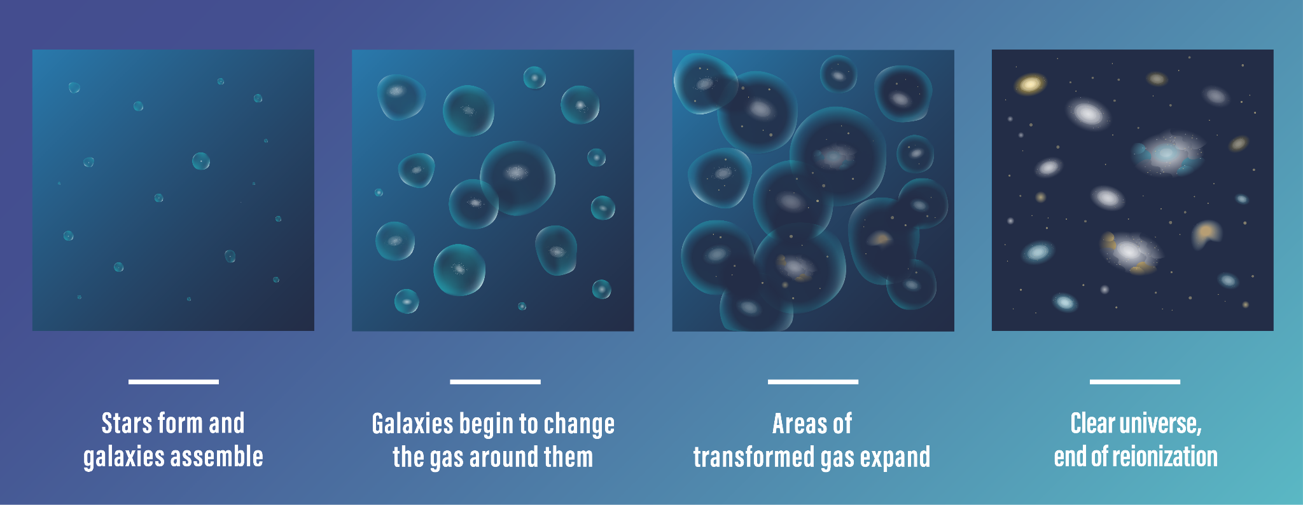
What is Reionization and When Does it Happen?
(NASA + 2023)
Notes:
Well, it matters because ionization is actually pretty fundamental to reionization, a phenomenon that’s responsible for how our universe looks today.
You see in the first 100 millions years of the universe ionizing light couldn’t travel far, always coming into contact with close up hydrogen making the universe opaque to it.
A billion years later though as ionization began to take its toll, the universe started to take the shape that it has today with less hydrogen gas between each galaxy and galaxies in general in more distinct groups.
In essence, this is why we’re interested in studying reionization because we want to get a better idea as to how this happened and how the universe formed.

Slide 4
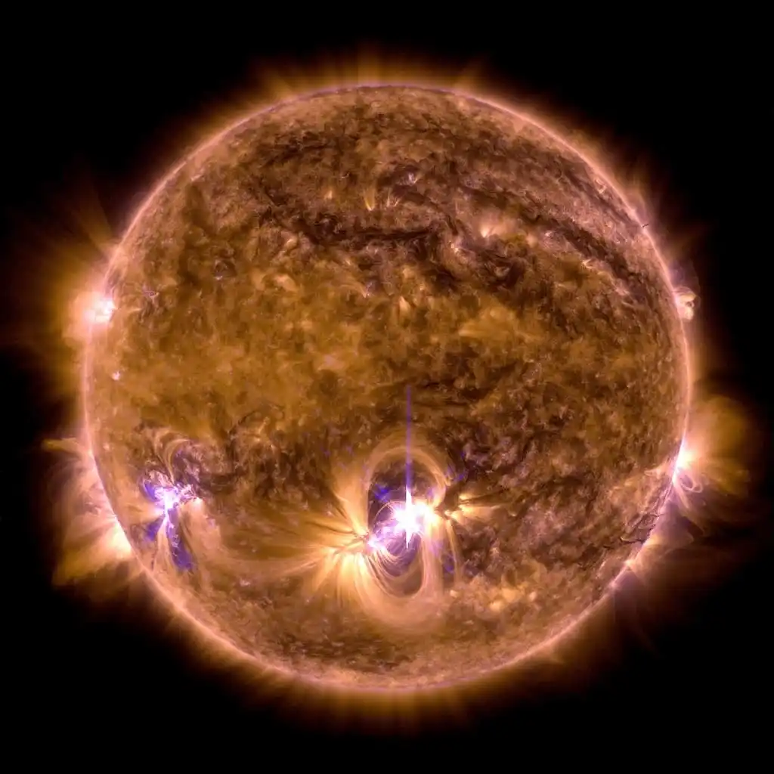
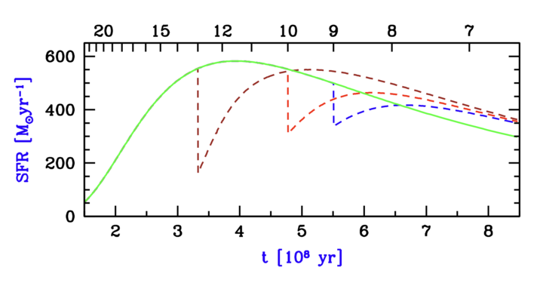
How does Reionization Impact Galaxy Evolution?
More Area
Less Area
z = 10
z = 13
z = 9
No Reionization
(NASA + 2023)
(Adapted From Barkana & Loeb 2018)
Notes:
You might be wondering though, what else does reionization affect?
In addition to the transparency of the universe to ionizing light reionization also affects star formation rates.
This because after it becomes ionized hydrogen can no longer turn into fuel for stars.
This basically means that more ionization means less star formation.
The graph on my left from Barkana & Loeb shows this pretty well. These different lines all show how star formation would have happened had reionization occured at different times.
On the Y-axis we have number of solar masses (or star masses equal to that of one sun) being produced per year, as a function hundreds of millions of years.
The different colored lines assume different times of reionization. The green line assumes no reionization, and the brown, red, and blue line show what would happen if reionization happened at redshift 9, 10, or 13, respectively.
What you’ll notice is that there’s a lot more area under the curve for that green line that assumes no reionization than there is for that blue line that assumes it happens at z = 13 or at the start of the universe.
And this dramatic difference shows pretty well just how big of a difference reionization makes toward how stars formed in our universe.

Slide 5

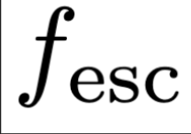

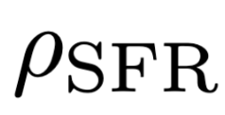

Star Forming Galaxies Drive Reionization
Ionizing Emissivity
The Three Parameters:
=
x
x
Ionizing Photon Production Efficiency
(What we’re researching)
Star Formation Rate
Fraction of
Escaping Photons
Notes:
Something else you might be curious about is if there’s an equation for reionization and as it turns out there is:
This equation here, Nion equals (f escape) times (psi ion) times (row SFR) is, in fact, the equation for how we determine how many ionizing photons are produced by a given galaxy.
For our research we are specifically focusing on (psi ion) or how the ionizing production efficiencies work in different galaxies in their production of ionizing photons.
That being said, the fraction of photons escaping a galaxy and the star formation rate of that galaxy also play a role in how many ionizing particles that galaxy produces.

Slide 6
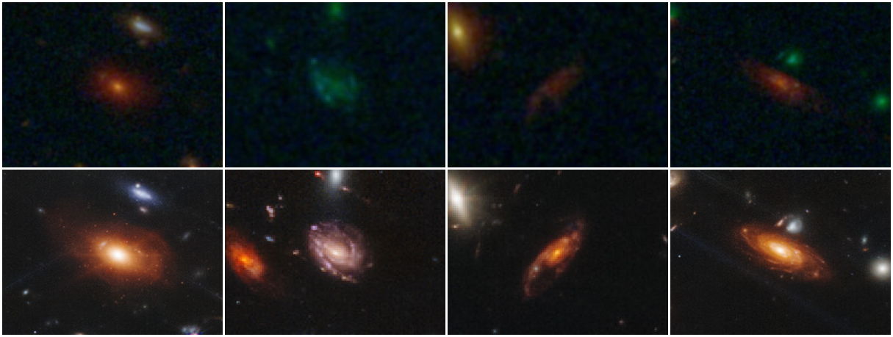
Why Study Reionization Now?
Hubble
JWST
(Roan Haggar 2023)
Notes:
But why study reionization now?
What makes now a better time than ever to look into reionization?
Well now is actually one of the best times to look into reionization because of the James Webb Telescope. Trying to understand something as old as reionization requires an ability to observe redder more red shifted versions of light, and until now we haven’t really been able to do that well.
What you’re seeing above captures just how much of a difference there is between observing high redshift galaxies using the Hubble v.s. The James Webb telescope and as you can see the spatial resolution and sensitivity of the telescope to high redshift light makes it much more accurate in collecting data on the shapes and sizes of these galaxies and what kind of light they’re producing. Something that’s crucial if you want to correlate galaxy size to ionizing photon production which is why now is a better time than ever to draw a correlation between the two.

Slide 7
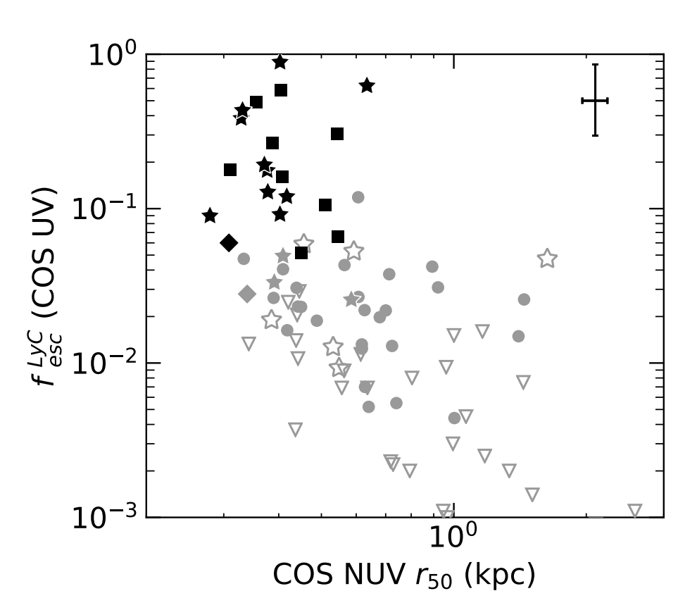
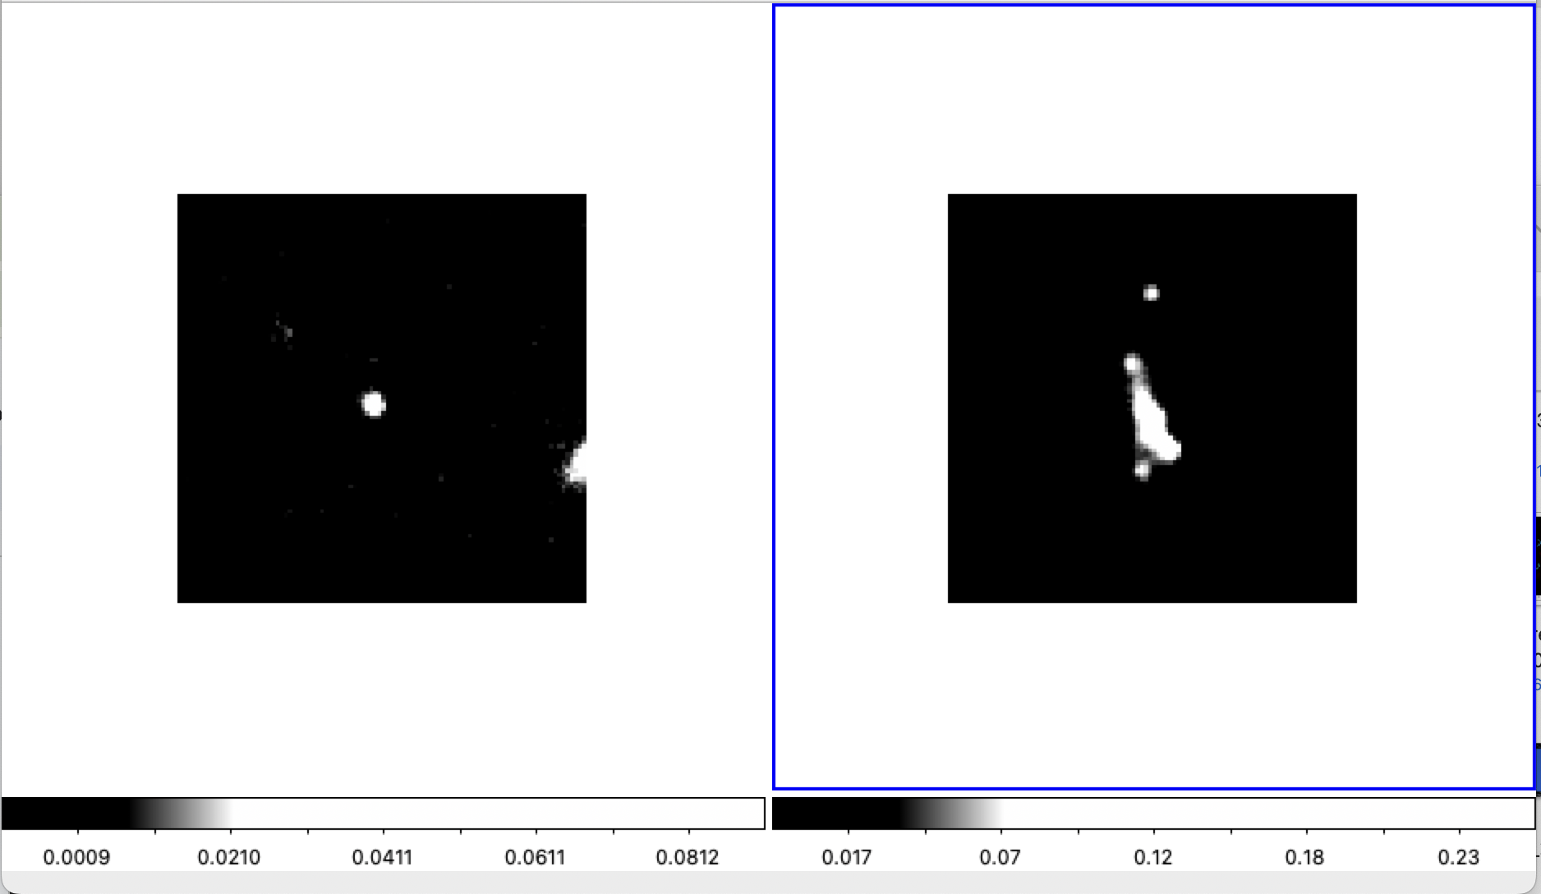
Why Care about Galaxy Size?
JADES-4297 v.s. JADES-21150
(Flury + 2022)
(Schmidt-Eder 2024)
Notes:
But where did we even get the idea to begin with that photon production efficiency could somehow be tied to the compactness of these galaxies?
Well what you’re looking at now is one of the motivating figures for our research project. It’s a graph from Flury et al. which shows a correlation between two units. The y-axis showing the fesc or escape fraction of escaping Lyc or Lyman continuum photons out of a galaxy. For context a lyman continuum photon is just a photon measured in the UV wavelength capable of ionization.
This is compared to galaxy size as a half life-radius in kiloparsecs which you guys probably know as a distance. The half-life radius part is just what we use to determine galaxy size as that’s where most of a galaxies content lies is within that first half of the light from the core.
Different shapes in the data points denote data taken at separate observation times and more filled in data illustrates more confident data. Anyways as you look you’ll notice an anticorrelation between the radii of these galaxies and the escape of this ionizing light which is what has motivated us to dive into this project and investigate this phenomenon further. We’re motivated to understand if these compact galaxies also have high ionizing photon production efficiencies because if they do it’s likely that they play a very large role in ionization.
**Only if asked
Reason for the datapoints above (if asked): I did discuss that region where they seem to be more clumped together at the top with my mentor and from what he told me there isn’t necessarily a reason for those data points that are clumped up together in that way that really stands out, but a reason for that scatter really could just come down to the fact that photon production efficiency isn’t just a function of radii, it causes the scatter that you see on the graph, and the reason for that clumping up as you get to the top is likely just another variable beside effective radii that becomes more pronounced as you get closer to the galaxy’s center.

Slide 8

Methods of Our Research
Notes:
Going into methods how are we studying reionization in our specific research

Slide 9
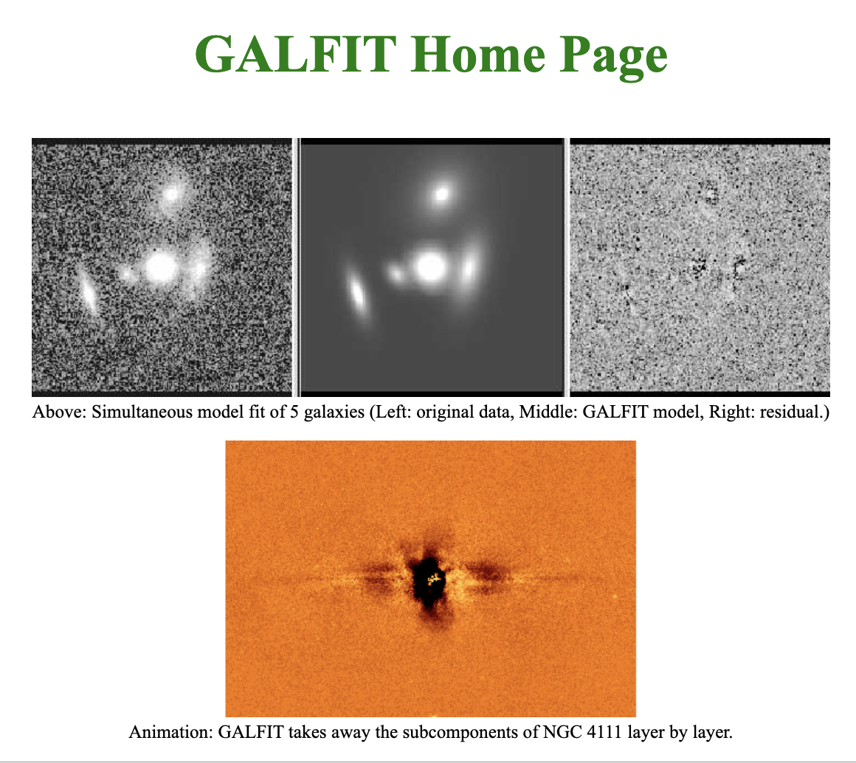
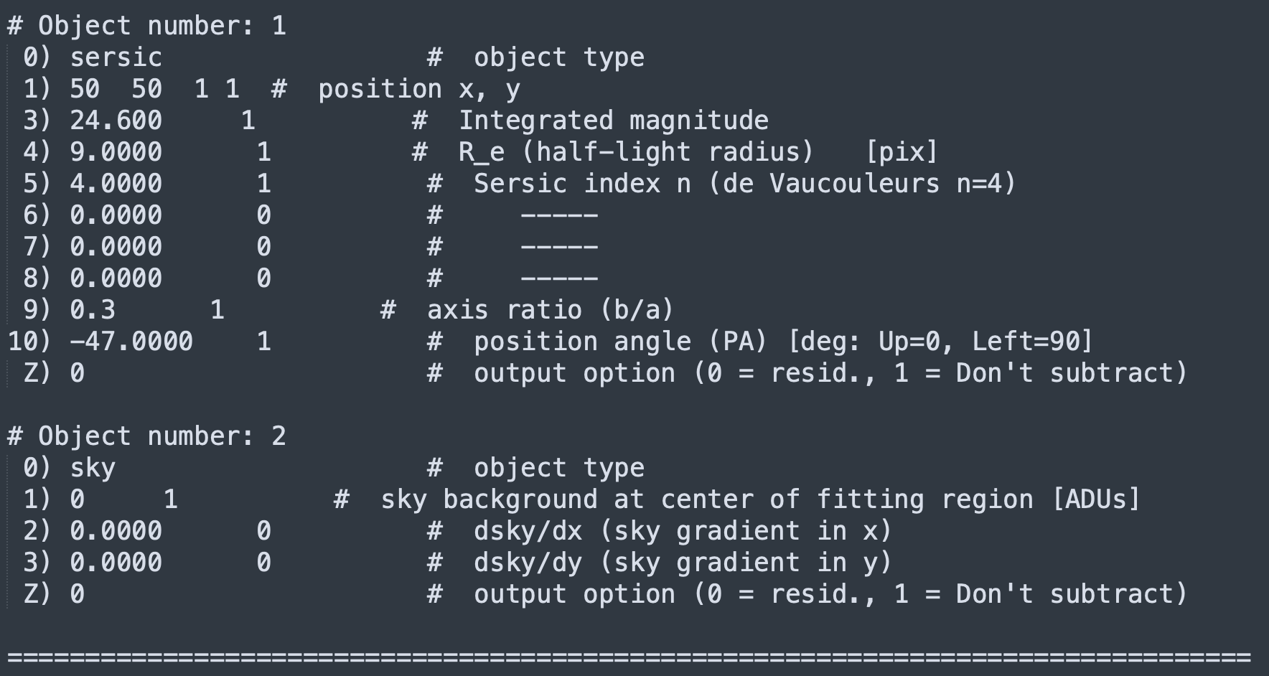
Galfit (Fits Models to Galaxies to Determine Their Size):
Peng (2010)
Notes:
So the biggest thing when it comes to determining the sizes of these galaxies is this program called Galfit.
It what we’ve been spending all our time collecting the prerequisites for, and it’s the tool that actually determines what the sizes of these galaxies are.
Basically what it does is it’ll take a science image, a point spread function, and a bad pixel map all of which I’ll explain, and it creates more accurate models of what the shapes of these galaxies really look like so we can determine their sizes.
There’s some manual parameters that you have to feed it, pictured to the right, which help it, so you can tell the program how big you think a galaxy is, if it was captured at an angle, how bright you think it might be, and from then on it’ll try to create a fit or a model as to what the size of that galaxy looks like using equations.
← Least squares optimization (if you want is how it does the fitting of the model to the science data).

Slide 10
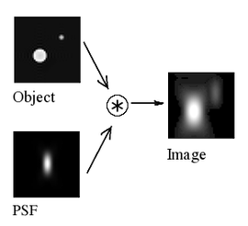
Point Spread Functions (Describe How Telescopes Spread Out Light):
(Default007)
Notes:
One of the things that Galfit takes is a Point Spread Function or a (PSF) and what a PSF will do is it’ll describe how a telescope is spreading out light. I don’t know how many of you guys know this but basically any time light enters some sort of optics, it’ll get spread out before becoming an image and what the point spread function will describe is by how much. It’s useful toward generating the model of the shape of our galaxy to measure its size because it helps us to account for this spread so we can get a more accurate representation of a galaxy’s shape.

Slide 11
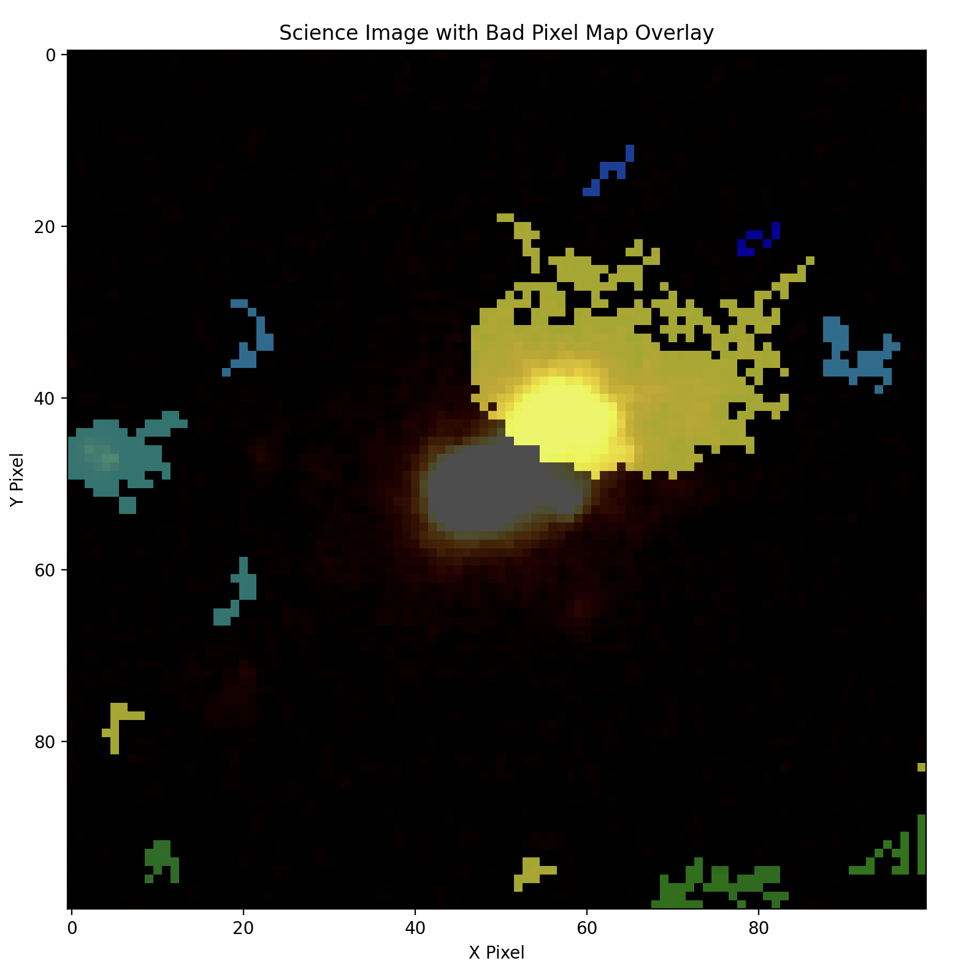
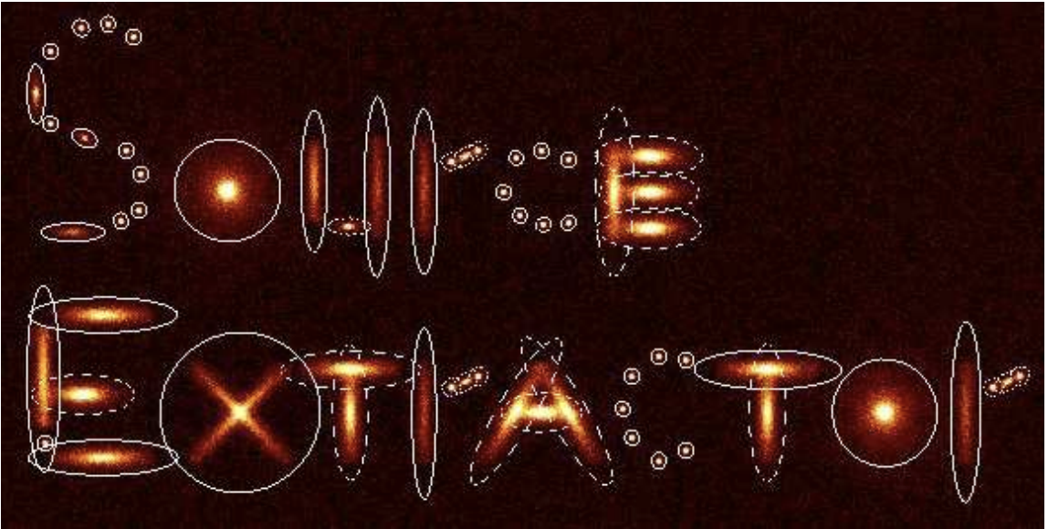
Source Extractor (Creates Bad Pixel Maps):
(Bertin and Arnouts 1996)
Schmidt-Eder (In Prep)
Notes:
Source Extractor is another prerequisite for Galfit that creates bad pixel maps. Essentially what that does is once we have the cut outs of our galaxies it’ll draw or mask out anything that isn’t meant to be the galaxy that we’re measuring in these little pixeled out colorful areas. I showed this figure two weeks ago and basically it helps to ensure that the light that we’re feeding Galfit is actually from the galaxy from the center of our cutouts instead of some other object near it that could mess up our model.

Slide 12
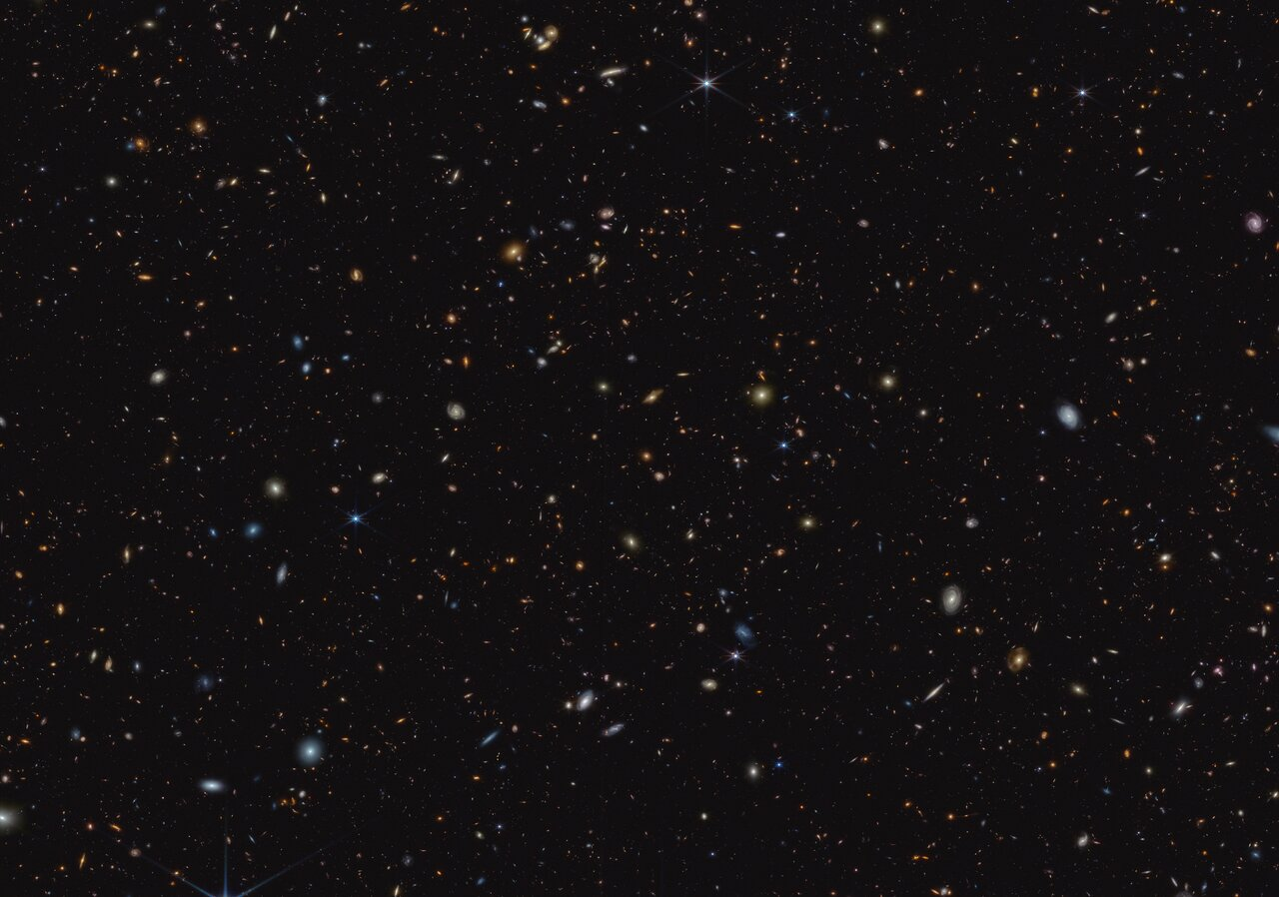
JADES (Where the Data Comes From):
JWST’s Advanced Deep Extragalactic Survey (JADES)
Field: GOODS-S
Filter: F115W
NASA, ESA, CSA, B. Robertson (UC Santa Cruz), B. Johnson (Center for Astrophysics, Harvard & Smithsonian), S. Tacchella (University of Cambridge, M. Rieke (Univ. of Arizona), D. Eisenstein (Center for Astrophysics, Harvard & Smithsonian), A. Pagan (STScI)
Notes:
GOOD-S is the name of the field of stars that we’re getting our data from. GOOD-S is basically just a field of stars that contains galaxies that are redshifted really far away which is why we use it. It’s also really well studied which will help us when we’re drawing conclusions about the data.

Slide 13
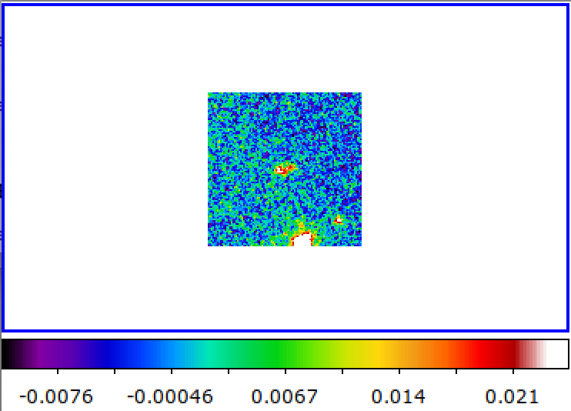
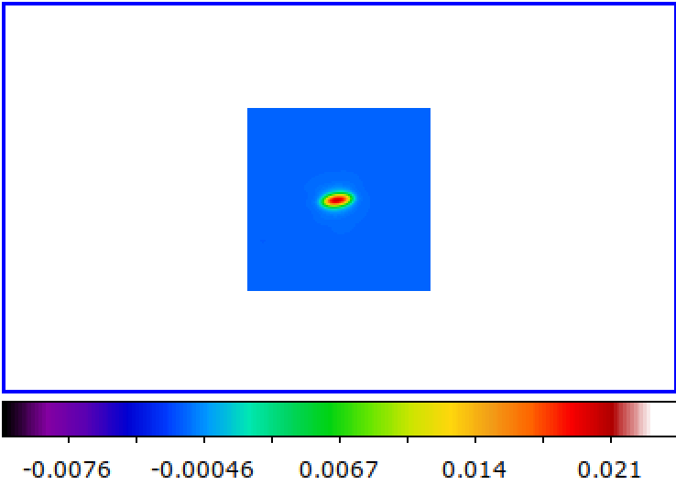
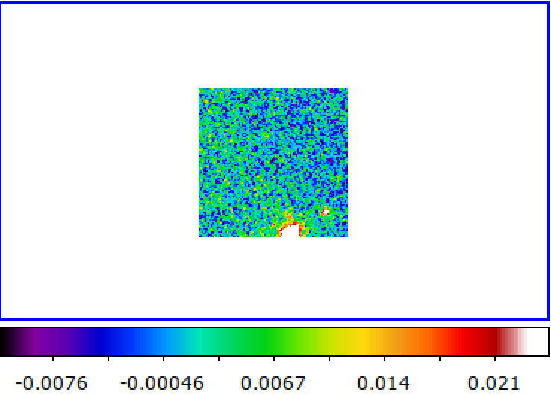
What Does Galaxy Size Measurement Look Like?:
Science Image:
Model:
Residual:
(Schmidt-Eder in Prep)
Notes:
Finally what does our data look like once we feed it all of the prerequisites?
Once we give Galfit everything that it wants it’ll spit out three things, the original science image of the galaxy, the model image, and this thing called the residual.
The science image is essentially the blurry galaxy that we first feed Galfit which comes from a an actual cutout of an image in the sky.
The model image is then what Galfit believes that galaxy actually looks like after we’ve accounted for the spreading out of the light, and the other light sources that might be messing it up.
Finally is the residual, which tells us how well our new model subtracts from the original background of the image. If the residual looks close to the background noise from the science image that’s how we’ll know that we’ve modeled our galaxy correctly. The residual tells us that there isn’t more or less light being produced by the model galaxy than what should be there.

Slide 14

Our Progress + Next Steps
Notes:
So next talking about our progress. For our research specifically so far we’ve generated our PSF for our star field, created the code that cut out our target high redshift galaxies, downloaded all of our dependencies, understood the underlying science, downloaded all the python packages, debugged Galfit and got everything running. We’ve just begun creating models for our first galaxies and will continue until we’ve measured the sizes of 40 different galaxies.
From then on out we plan to run our correlation tests between ionizing production and galaxy effective radii. We might even experiment with making a graphical interface for Galfit once we’re done since it’s a fairly terminal-intense program that wouldn’t be that intuitive for first time users.

Slide 15

Summary and Takeaway:
Reionization is neutral hydrogen in the Intergalactic Medium (IGM) transitioning to ionized.
Star formation was responsible for the production of ionizing photons in the early universe..
Galaxy size is the main thing we’re attempting to measure so we can determine if compact galaxies drive reionization.
Galfit fits models to galaxies to determine their size.
(Schmidt-Eder in Prep)
Notes:
Lastly here is the summary and some takeaways.
Reionization or the transition of the universe’s hydrogen from neutral to ionized is what our research is about.
Reionization was responsible for star formation in the early universe and the clarity of the galaxy.
Galaxy size is the main thing we’re attempting to measure so we can determine just how much of a role galaxy radii had in this ionizing photon production.
Galfit is the main tool of our research. Galfit creates the models of the galaxies which become the radii for our correlation.

Slide 16
That’s It! / Questions (Sources)
References
Fan, X., Carilli, C. L., & Keating, B. 2006, , 44, 415,
doi: http://doi.org/10.1146/annurev.astro.44.051905.09251410.1146/annurev.astro.44.051905.092514
Flury, S. R., Jaskot, A. E., Ferguson, H. C., et al. 2022, , 260, 1,
doi: http://doi.org/10.3847/1538-4365/ac533110.3847/1538-4365/ac5331
3
Robertson, B. E., Ellis, R. S., Furlanetto, S. R., & Dunlop, J. S. 2015,
, 802, L19, doi: http://doi.org/10.1088/2041-8205/802/2/L1910.1088/2041-
8205/802/2/L19
4
Notes:
And that is the end of my presentation I will now take questions.

